Slide 1
Beer Data Presentation - Resampling Task
Marcus Debnar – S2310454007 Stefan Habringer – S2310454013

Slide 2
Objective
Create additional data by sampling from the existing dataset
Skew resample to the left side of the distribution to simulate „bad“ additional data
Run Symbolic Regression and Clustering Algorithms on existing dataset, resample and combination

Slide 3
Data Preparation
41467_2024_46346_MOESM4_ESM.csv && 41467_2024_46346_MOESM7_ESM.csv
Merged Datasets – Overall Rating
Removed (>30) and Resampled (<=30) NaN‘s Column values
Created Data Set for Partition with Overall Rating as Category (Not enough, Sufficient, Satisfying, Good, Very good)

Slide 4
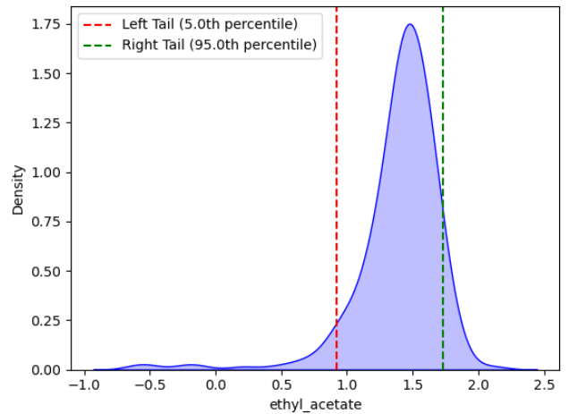
Resampling
Sample from left side distribution
Selected parameters:
Important parameters from the paper (ethyl_acetate,ethanol, ethyl_octanoate, ethyl.phenylacetate, protein, lactic_acid)
Correlataion induced (ethyl_acetate, kcalperc, isobutyl_acetate, H2S)

Slide 5
RESULTS CLUSTERING
TODO

Slide 6
RESULTS SYMBOLIC REGRESSION
TODO

Slide 7
Lessons Learned
Resampling alogorithm needs finetuning
Additional information from sampling data lead to diverging results – with lower quality
Clustering did not work properly, even after defining Quality as a categorical variable

